Slide 1
FlipFit: Gym Management System
Group H

Slide 2
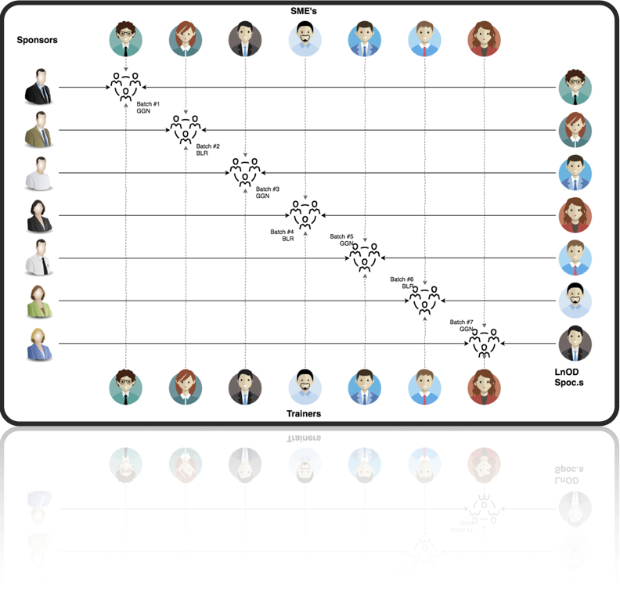
Stakeholders
Sponsor : Flipkart
SME’s : Amit Balyan
Coordinators : Raksha Dubey

Slide 3

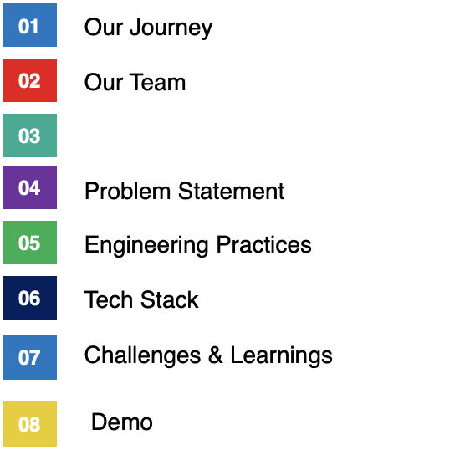
Agenda
Team Structure

Slide 4

Our Team
Aryan Sonwatikar
Aryan Parmar
Darsh Bhavin Doshi
Kuhu Gupta
Nakka SaiKrishna
Smit Bagadia
Shlok Patel
Shrishti Akhouri
Yatharth Nanda

Slide 5


Slide 6
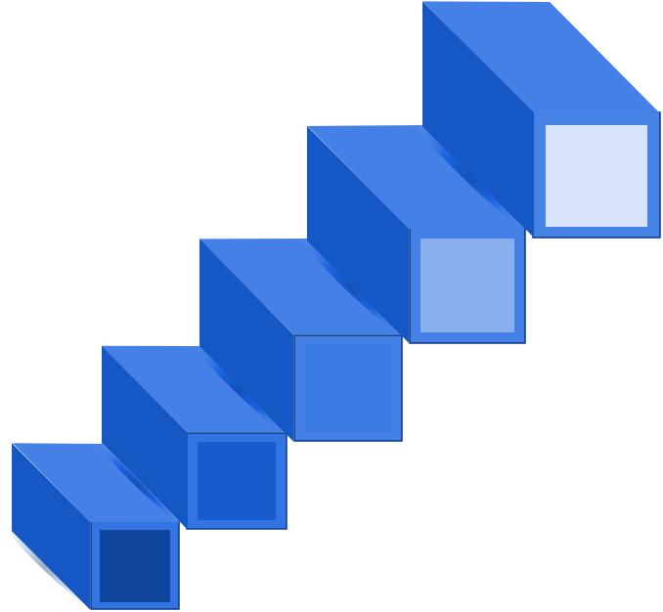
Project Demo
5
4
Testing on Console
Architecture Design and Development
3
2
Understanding the technology stack required for the project
Understanding Project Requirements and Goals
1

Slide 7
Action Plan
Day 1: Making a rough implementation for design flow of flipfit application.
Day 2: Getting ready with the uml diagrams(class,use case and activity flow) and getting it reviewed.
Day 3: Getting accustomed to git, spring tool suite.
Day 4: Getting started with java application code(packages: bean, business and client)
Day 5: Designing the database schema and getting started with DAO implementation.
Day 6: Testing and improving userflow.

Slide 8
Problem Statement
Lack of a centralized platform to book gym slots in partner fitness centers.
Users face uncertainty in slot availability, leading to inconvenience.
Gyms struggle with manual slot management and tracking bookings.
Need for a seamless booking experience with real-time availability.
Our solution
A user-friendly platform to discover and book workout slots at partner gyms.
Real-time slot availability based on gym capacity.
Admin dashboard for gyms to manage slots and track bookings.
Scalable backend system ensuring smooth operations and future expansion.

Slide 9
Engineering Practices
Testing & Integration
.
05
Implementation
Code development
01
04
Software Development Cycle
Design
UML Artifacts ,Architectural design
Planning:
Requirement Gathering.
02
03
Analysis
Tech stack

Slide 10
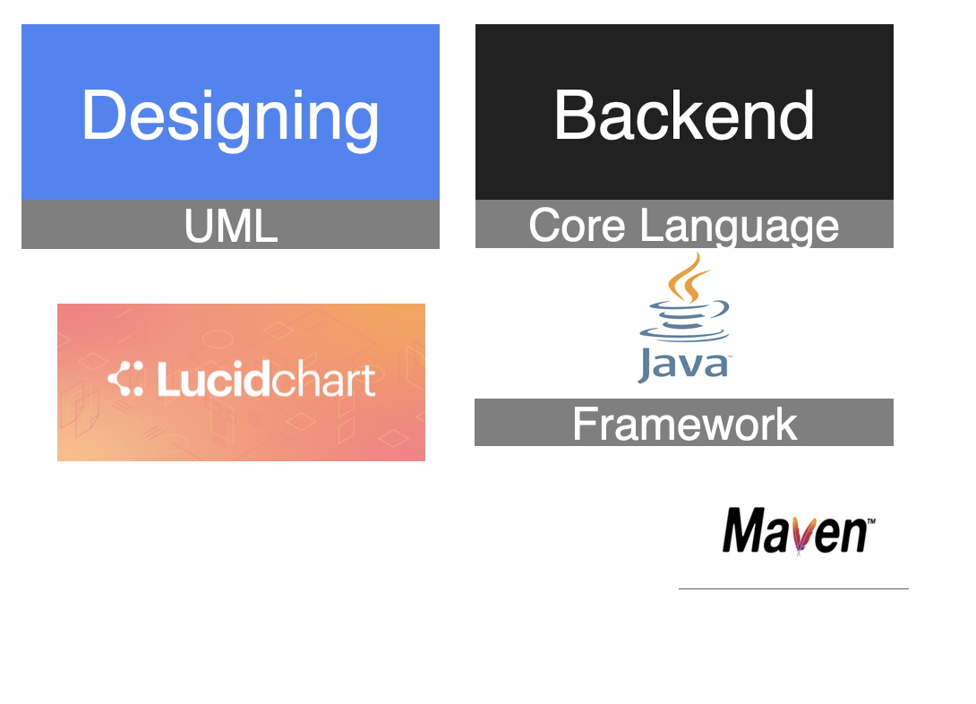
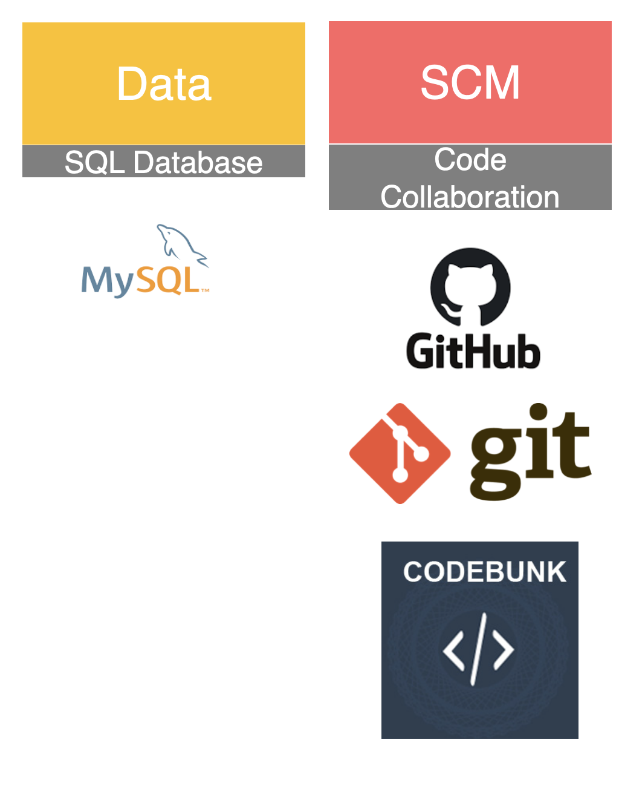
Tech Stack:

Slide 11
UML Diagrams
Use Case Diagram
Activity Diagram
Class Diagram

Slide 12

Use Case Diagram
Flipfit Customer Usecase Diagram
Flipfit GymOwner Usecase Diagram
Flipfit Admin Usecase Diagram

Slide 13
Activity Diagram
Flipfit Customer Activity Diagram
Flipfit GymOwner Activity Diagram
Flipfit Admin Activity Diagram

Slide 14
Class Diagram
Class Diagram

Slide 15
Challenges and Learnings
Learning new tech stack and implementing pre-existing knowledge to build a real life application
Normalising database and reducing redundancy
How to streamline design of application using UML diagrams
Teamwork and collaboration with developers using Git

Slide 16
Future Work
Conclusion
Implementing wait-list system to efficiently utilize slots when cancelled by another user
Building a web page frontend to facilitate user application
Adding another role for trainers and allowing customers to book them for personal training sessions
We successfully implemented admin, user and gym owner side of our application, integration of database and learnt real life implementation on the way.

Slide 17
Thank You!

